Slide 1
Image Processing Technical Problem Solving Contactless fingerprint capturing
Name : Mahesh M Dhananjaya
Matriculation No: 11012403
Guide: Prof. Dr. Ing Christof Jonietz

Slide 2
Flowchart
Skin colour based hand segmentation
Finger separation
Fingerprint extraction from the finger

Slide 3
Skin colour based hand segmentation
The approach used is from:
A. Cheddad , J. Condell, K. Curran, and P. McKevitt . “A new colour space for skin tone detection.” IEEE International Conference on Image Processing (ICIP) ICIP), 2009 16th, pages 497 500, Nov 2009.
Program algorithm:
Capturing the image from the camera.
Image Smoothing: using median filter to reduce the number of blobs after thresholding.

Slide 4
Thresholding using the above paper:
Set the red colour matrix to zero and create a new matrix with the largest values from green or Blue colour.
Create another matrix which is the Gray scale of the captured image.
Determine the error matrix which is the difference of the above two matrix.
According to the skin probability map – the boundaries of skin colour is between 0.02511 and 0.1177 or 6 and 30 (uint type).
Threshold the error matrix using the above values. i.e
1 if 0.02511 <= e(x) <= 0.1177
0 otherwise
Fine adjustments can be done using a track bar.

Slide 5

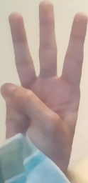
Filtering the blobs after thresholding:
The area of all the blobs are calculated and the largest area is selected, on the assumption that the hand is the largest blob of the captured image.
The region of interest of this hand blob is cropped and used for further analysis.

Slide 6

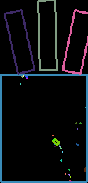
Finger separation
The Region of interest contains both fingers and palm. To differentiate between the fingers and the palm, a black line is drawn across the image which divides the palm and the fingers.

Slide 7
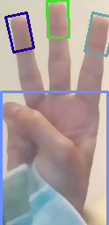
Fingerprint extraction from the finger
To extract the fingerprint a rectangle is created at the tip of the finger with the length = 1.5 times the width of the finger.

